Slide 1
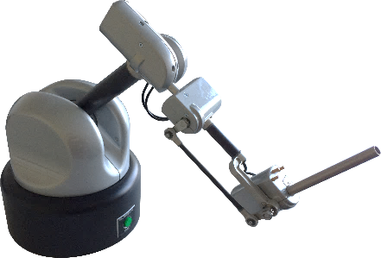
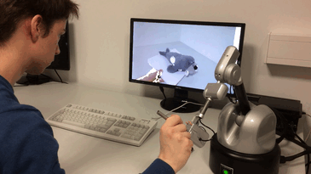
A Volumetric Penetration Measure for 6-DOF Haptic Rendering of Streaming Point Clouds
Maximilian Kaluschke¹, Rene Weller¹, Gabriel Zachmann¹
P2.64
¹University of Bremen
Visit our demo booth D1.25
Thank you for your attention!

